Slide 1


VA Solid Start – Architecture and Design
Microsoft confidential. For internal use only.

Slide 2

Mental Health Executive Order
Project Overview
VA Solid Start Functional Overview
Agenda

Slide 3

Project Objectives

Slide 4
Executive Order 13822
The Executive Order directs the U.S. Departments of Veterans Affairs (VA), Defense (DoD), and Homeland Security (DHS) to work together to ensure newly discharged Service members and Veterans have access to any needed mental health care for at least one year following their discharge from military service. To achieve this, the Executive Order required the agencies to develop a Joint Action Plan.
You can read more about the Executive Order 13822 here.

Slide 5
Functional Overview
Data Import and Staging
Data Sources
VADIR
LGY and Education
VHA
VGLI
Post Import Processing
VASS Interactions
Assignment across VA National Call Centers
Reporting
VASS Coaches
Assignment across agents within a call center
VASS Agents
Outbound Calls
Inbound Calls
VASS Admins
Assignment and Outreach

Slide 6
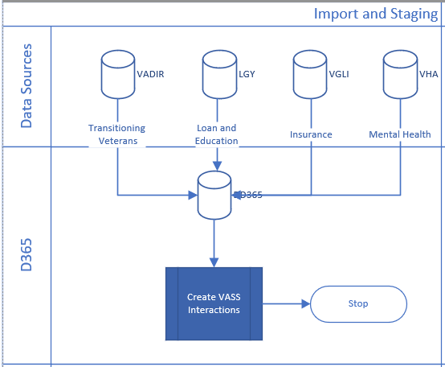
Import and Staging

Slide 7
Import and Staging
VADIR
LGY / Education
Updates Education / Loan attributes in Contact
Populates/Updates attributes from the VADIR system.
Creates new VASS Interactions, Contacts
VGLI
Update Insurance attributes on Contact
VHA
Helps identify “at risk” Veterans

Slide 8
Assignment and Outreach
VASS Admins
Assign VASS Interactions to National Call Center
VASS Coaches
Assign Interactions to VASS Agents
Admins transfer VASS Interactions from VASS National to VASS Call Center Teams
All VASS Interactions are owned by VASS National Team
Manage, monitor and assign VASS Interactions at National Level
Track the Progress of Teams
VASS Agents
Outbound Calls
Inbound Calls
Each VASS Call Center has a VASS team associated with it. The team name is prefixed with VASS.

Slide 9

Questions

Slide 10
© 2015 Microsoft Corporation. All rights reserved. Microsoft, Windows, Windows Vista and other product names are or may be registered trademarks and / or trademarks in the U.S. and / or other countries. The information herein is for informational purposes only and represents the current view of Microsoft Corporation as of the date of this presentation. Because Microsoft must respond to changing market conditions, it should not be interpreted to be a commitment on the part of Microsoft, and Microsoft cannot guarantee the accuracy of any information provided after the date of this presentation. MICROSOFT MAKES NO WARRANTIES, EXPRESS, IMPLIED OR STATUTORY, AS TO THE INFORMATION IN THIS PRESENTATION

